Slide 1
Theory of Knowledge (TOK)
TOK Introduction, Assessment etc.
The written curriculum: what it is, what it is not
Where to find TOK relevant material for the subjects

Slide 2
Carolus Linneaus (Carl Lineé) formalized binomial nomenclature
How can the categorization and grouping of objects be helpful or problematic for gaining new knowledge? Are such groups not an invention of the human mind?

Slide 3
Carolus Linneaus (Carl Lineé) formalized binomial nomenclature

Slide 4
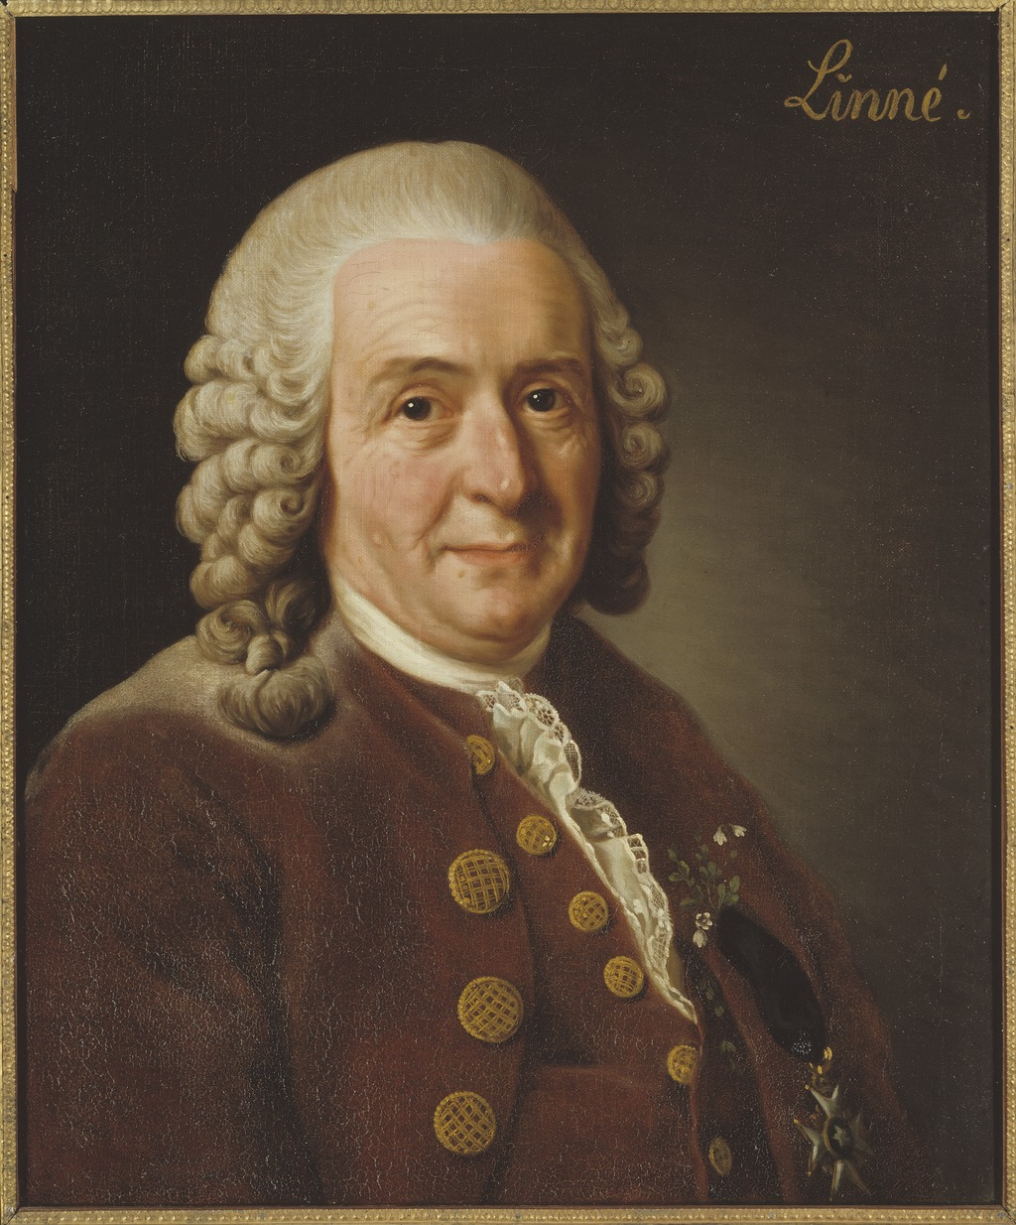
Carolus Linneaus (Carl Lineé) also classified humans
The Americanus: red, choleraic, righteous; black, straight, thick hair; stubborn, zealous, free; painting himself with red lines, and regulated by customs.^{[19]}
The Europeanus: white, sanguine, browny; with abundant, long hair; blue eyes; gentle, acute, inventive; covered with close vestments; and governed by laws.^{[20]}
The Asiaticus: yellow, melancholic, stiff; black hair, dark eyes; severe, haughty, greedy; covered with loose clothing; and ruled by opinions.^{[21]}
The Afer or Africanus: black, phlegmatic, relaxed; black, frizzled hair; silky skin, flat nose, tumid lips; females without shame; mammary glands give milk abundantly; crafty, sly, lazy, cunning, lustful, careless; anoints himself with grease; and governed by caprice.^{[22]}
The Monstrosus were mythologic humans which didn't appear in the first editions of Systema Naturae.

Slide 5
The IB Biology Syllabus explicitly mentions TOK

Slide 6
What is TOK?
Oliver: A course where you ask questions that you normally would not ask
Oliver: An applied philosphy course
IB: It is NOT(!) philosophy!
  They do not want that you teach philosophy theory. They want you to apply it.
  They seem to be worried, if it is taught like a philosophy course and they explicitly say that teaching TOK is more about a certain mind-set than about formal training in philosophy. It is a course designed to be taught by any teacher, regardless of background.
Student: A course that makes fun of other school subjects.
  Oliver: „What do you mean“? Student: „We are questioning the nature of the school subjects and this makes them appear rediculous.“ Oliver Kim: „But this is not the point!“
A course that deals with knoweledge issues: „How do I know that…“

Slide 7
Purposes of TOK
To question the nature of your own subject
To shape critical thinking (critical thinking = balanced thinking)
To discuss how knowledge is gained in your subject and the advantages and disadvantages
How do you gain knowledge in the sciences?
  Scientific method (empirical studies), falsification of theories, interpretation of results, simple luck (serendipity) etc.
How do you gain knowledge in math?
  Mathematical proofs…
History:
  Selection of facts, interpretation of facts to come up with a narrative that explains causes and effects.

Slide 8

IB History
International educational foundation, non–profit.
Headquartered in Geneva, Switzerland
Founded in 1968
Marie-Thérèse Maurette: Booklet entitled "Do Education Techniques for Peace Exist?” (1948) following a request of the UNESCO. In this booklet she described a framework for what would eventually become the IB Diploma Programme (IBDP).
1960s: teachers from the International School of Geneva (Ecolint) created the International Schools Examinations Syndicate (ISES), which would later become the International Baccalaureate (IB).
2017: 3262 IB Diploma Schools alone (compare this to 345 AHS in Austria in 2013-14)
CAS/TOK anecdote.
Fun reading: https://www.theguardian.com/education/2006/mar/14/schools.schoolsworldwide

Slide 9
Guardian:
A US school district has banned the International Baccalaureate after officials condemned it as "un-American" and Marxist, sparking outrage among pupils who are studying the increasingly popular diploma. […]
A recent row that failed to overturn the IB in the Fairfax district of Virginia also had opponents accusing the curriculum of promoting "disarmament, socialism and moral relativism, while attempting to undermine Christian religious values and national sovereignty".
Most of the complaints emphasise the IB's teaching of a theory of knowledge course on philosophy and ethics, and that it offers subjects such as environmental systems, technology and social change, peace and conflict studies and experimental science, with an international flavour, alongside the "drier" subjects such as English, maths, history, geography, physics, chemistry, biology and foreign languages, that stir less debate, but are actually a much larger part of the core curriculum.
"Some people claimed the IB was an international conspiracy," said Janice Leslie, director of instruction for the Fairfax district.

Slide 10
Why TOK and CAS?
George Walker (former Director of the IBO, former Director of the ISG), at a recent talk given at my school:
"In the early years, those pioneering the IB really wanted to have the French on board. Today, the French don't have very much to do with the IB, and seem rather uninterested in it. But back then, in the 1960's, there was a great deal of discussion between the French and the British about the necessary features of a good Secondary school education.
The French found it simply inconceivable that anyone could graduate from Secondary education and go on to University without having studied Philosophy. They thought Philosophy was absolutely central to any good Secondary education. And so TOK was born, as a way of satisfying the French, enabling them to view the IB diploma as equivalent to a French Baccalaureate degree. On the other hand, the British found it simply inconceivable that any good Secondary program would not feature compulsory Sports. So that's how CAS was born: as a kind of 'compromise' that stressed the more active, participant, action-oriented learning that the British wanted included." -- George Walker, TASIS general faculty meeting, Thursday, March 26, 2009.
(Laurence Koppe, OCC Forum)

Slide 11
TOK as part of the IB Diploma Programme (IBDP)
6 Subjects: 3 HL and 3 SL (some Pflichtgegenstände, some WPG)
Theory of Knowledge (TOK): Pflichtgegenstand auch für jene, die keine IB Prüfungen ablegen.
Extended Essay (EE): Counts for VWA
Creativity Activity Service (CAS): UÜ, „teilgenommen“
IB Points
  6 Subjects, max. 7 pts. each = 42 points max
  EE + TOK = 3 pts. Max
  Total pts = 42 + 3 = 45

Slide 12
The Matrix
TOK = TOK Essay +
TOK Presentation
(TOK Essay is not the same as Extended Essay)
Criticism 1: One single component (the EE in this case) can result in the student not getting the IB Diploma.
Criticism 2: Few points for much work.
Retake of the EE and TOK is possible.
It is possible to use the same subject/topic, but not with VWA.
Change in subject only possible at next May session (do not allow).
Grade N: No EE, plagiarism, etc.

Slide 13
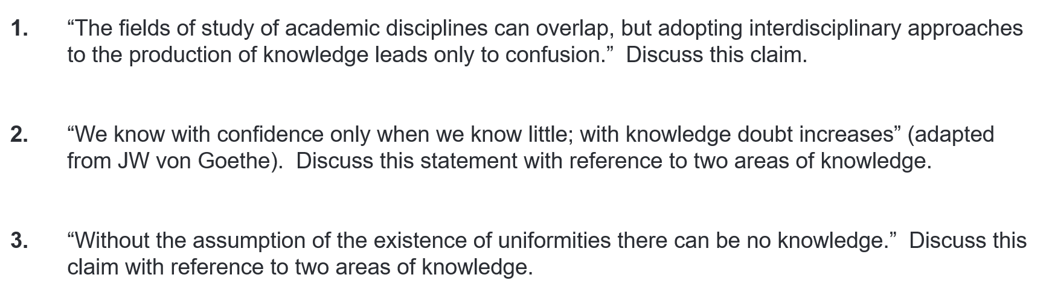
The students have to do…
TOK Presentation: students choose a topic
TOK Essay (1600 words): 6 topics are given, student chooses one. Example:

Slide 14
What is the Written Curriculum
Jahresstoffverteilung
Not a day-to-day lesson plan (said the IB)
Evidence that you will teach the IB (and TOK) in your subject
With the exception of Mathematics and German A (schriftl. Matura) – ignore (!!) the AHS Lehrplan. For the WPGs you can do this anyway, but you also do this for other non-WPG subjects that are relevant for the IB. If someone companins about this, then tell them (choose your favorite justification):
  AHS Lehrplan is a Rahmenlehrplan. You as the teacher have the right and obligation to interpret the AHS Lehrplan to suit the school profile.
  You are required to teach IB material becasue you are a Schulversuch.You are not allowed to deviate from the Bescheid of the Ministerium.
  The Schulversuch is irrelevant anyway, because it only applies to subjects that are not part of the original Stundentafel. It does not matter if you are a Schulversuch or not, as a teacher you have the right to interpret the AHS Lehrplan the way you want. Any you will replace it with the IB (said a person of authority, not I).
  You are not allowed to teach material that is not IB relevant, because you will not have enough hours to complete the IB (the IB will complain to you otherwise).
  The written curriculum is the official Lehrplan of your school and it was agreed that this contains only IB relevant material.

Slide 15
How to do the Written Curriculum
Topic allocation: Decide which IB topics should be taught in the Pflichtgegenstand and which in the IB WPG (if you split the course up). Remove all topics of the Austrian Curriculum that are not relevant for the IB. You will otherwise run out of time. Reinterpret the remaining parts of the AHS curriculum in such a way that they fit the IB. Make a Jahresstoffverteilung by copy-pasting the chapters. Take available teaching hours into consideration.
Teacher cooperation: Techers of the Pflichtgegenstand and the WPG must work together. There must be agreement of the topics taught. Very important. Teachers of the lower classes (5-6 Kl.) must be informed on the IB topics so that they can start preparing the students. Adjust the curriculum of these classes as well. „Lehrpläne der 5. und 6. Klasse ausmisten und IB-konform machen. Beurteilungssystem anpassen, wo sinnvoll. Lehrpläne der 7 und 8 Klasse für das IB neu aufstellen.“
TOK: Copy-paste TOK questions that you have from the syllabus or your own (!!!) to the Jahresstoffverteilung and clearly label it TOK. Make it visible to the IB that you include TOK material. Maybe you are already teaching TOK content without knowing it. Make those stories/examples visible in the Written Curriculum and label them with „TOK“.

Slide 16
Why do I have to include TOK in my curriculum? Why does the IB not tell me?
How can the mixing of languages help or hinder the communication of complex topics?
Question 2: What is the point of making my own curriculum, if the IB already has a syllabus?
Answer 1: they want you to find your own way of including TOK and they want that you “auseinandersetzen sich” with the course material.
Answer 2: They want to see evidence that you will implement (“umsetzen”) IB stuff in your teaching.
Answer 3: They give you the freedom to choose your own TOK topics to be included.
When you cover TOK topics in your (non-TOK) course, tell the student that this is TOK, so that they can use the example for their presentation and essay.

Slide 17
Where can I find help for including TOK material in my curriculum?
There is an IB syllabus and in many syllabi, there will already be TOK topics explicitly included. They have done the work (partially) for you. Same for some IB textbooks.
RTDIBS: Read the damn IB Syllabus.
Why is it, that the connotation of words (such as the f-word) is seen differently among different cultures?

Slide 18
Where can I find TOK relevant material?
RTDIBS! TOK Syllabus!

Slide 19
Get the religion, ethics, philosophy teachers involved!
Religion teacher: AOK religious knowledge systems
Ethics teacher: They should supply a list of topics that they cover in class. These topics can/should be linked to the different AOK, eg: genetic engineering article is linked to AOK science.
German teacher:
  Reading „Was ist Aufklärung“ von Kant (link to AOK reason).
  Reading „Im Westen nichts Neues“ von Remarque (link to AOK History. How can fictional novels help us understand history? Role of emotion to understand histroy?)
Philosophy teacher: can provide TOK theory in the chapter „Erkenntnistheorie“

Slide 20
Strategy
The IBO wants to see TOK included in the teaching of IB subjects. This can be done either in the “core” courses (PG), where IB curriculum has to be done anyway, or in the IBDP courses (WPG).
There are several ways in which TOK can be included in a non-TOK course:
  By specifically teaching TOK relevant material, which is linked (!!!) to the subject content. Include this explicitly in the curriculum that you have to make. You use “TOK theory” and apply this to your course material.
  By a specific, reflective, critical teaching attitude (this one is difficult to explicitly include in the curriculum).
  By explicitly including TOK topics that the IB (or other organizations) already prepared for you.

Slide 21
Key terms
Ways of Knowing (WOK): Language, Sense perception, Emotion, Reason/Logic, Imagination, Faith, Intuition, Memory
Areas of Knowledge (AOK): Ethics, Natural Sciences, History, Math, Arts, Human Sciences (Psychology etc. not medicine), Religious Knowledge Systems, Indigenous Knowledge Systems.
Knowledge Issues (KI), Problems of Knowledge (POK), Knowledge Questions (KQ)
I know that cells exist, becasue I read about them (language) and becasue I can see them under the microscope (sense perception).
I know that

Slide 22
TOK Theory: Different kinds of knowledge
Why 360? Why not 100 degrees? What role do traditions and conventions play in mathematics? [360° becasue of 365 days in a year. It simply has been agreed on. The reason is not mathematical.]
Personal knowledge: Knowledge that one individual built up by experience. „I know that insects make me feel disgusted.“
Shared knowledge: Knowedge that is common within a group of people. „I know that insects have 6 legs.“
Declarative knowledge: knowledge of facts. „I know that a circle has 360 degrees“.
Procedural knowledge: knowledge that requires practice. „I know how to use the microscope, how to solve equations, how to walk.“
Ask yourself: What parts of my IB course contain these types of knowledge? What are the facts (declarative), what are the skills (procedural) that students should know?
Personal knowledge = „kennen“ Shared knowledge = „wissen“
  „Ich kenne dich.“ „Ich weiss dich.“
  „Ich kenne, dass Zellen klein sind.“ „Ich weiss, dass Zellen klein sind.“
Can some ideas be better expressed in some languages, compared to others? In the German language, you have two different words for shared and personal knowledge.

Slide 23
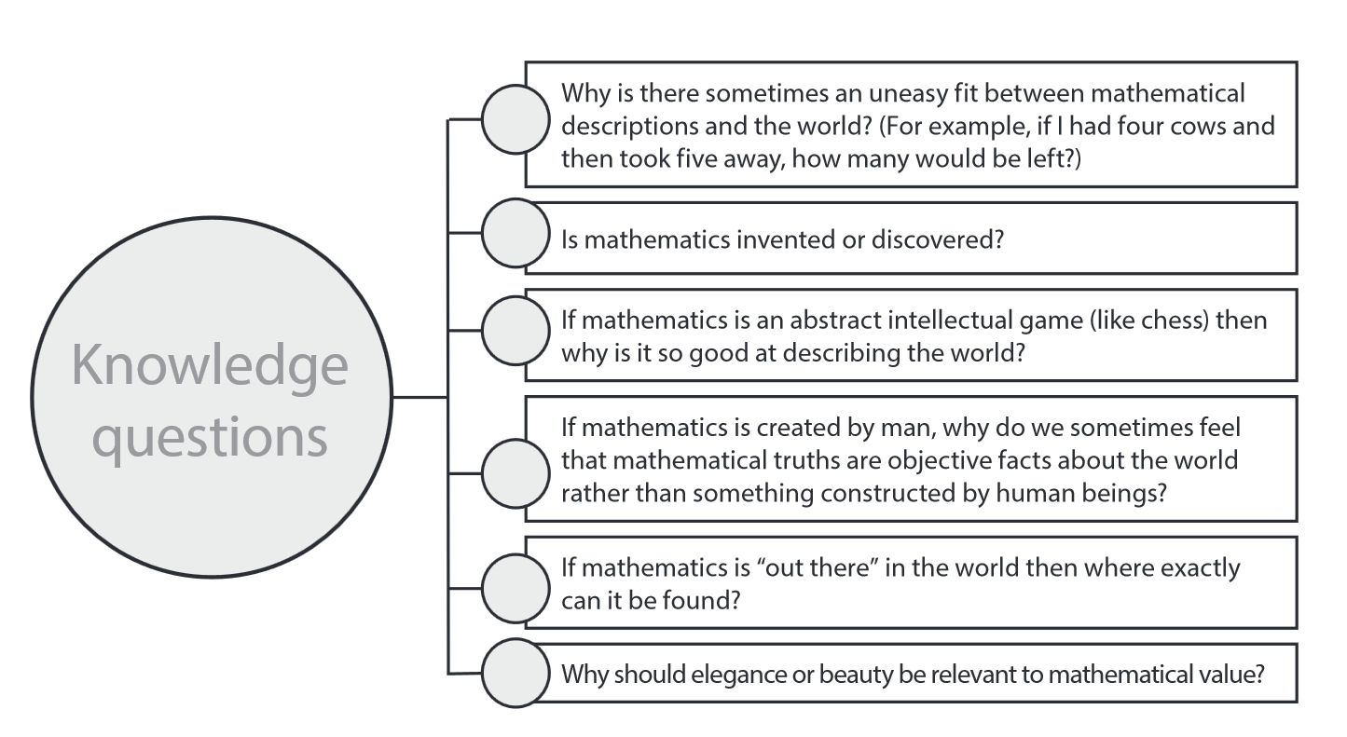
KI for Mathematics
Because Math is a model and a model is never perfect?
Both? What do these words mean?
Becasue „useless“ formal systems are not passed on, used, kept?
Because we like the objectivity and certainty of math?
Can it exist „out there“ without a human brain?
Maybe becasue we have no other words than elegance, beauty? Becasue we like simplicity?

Slide 24
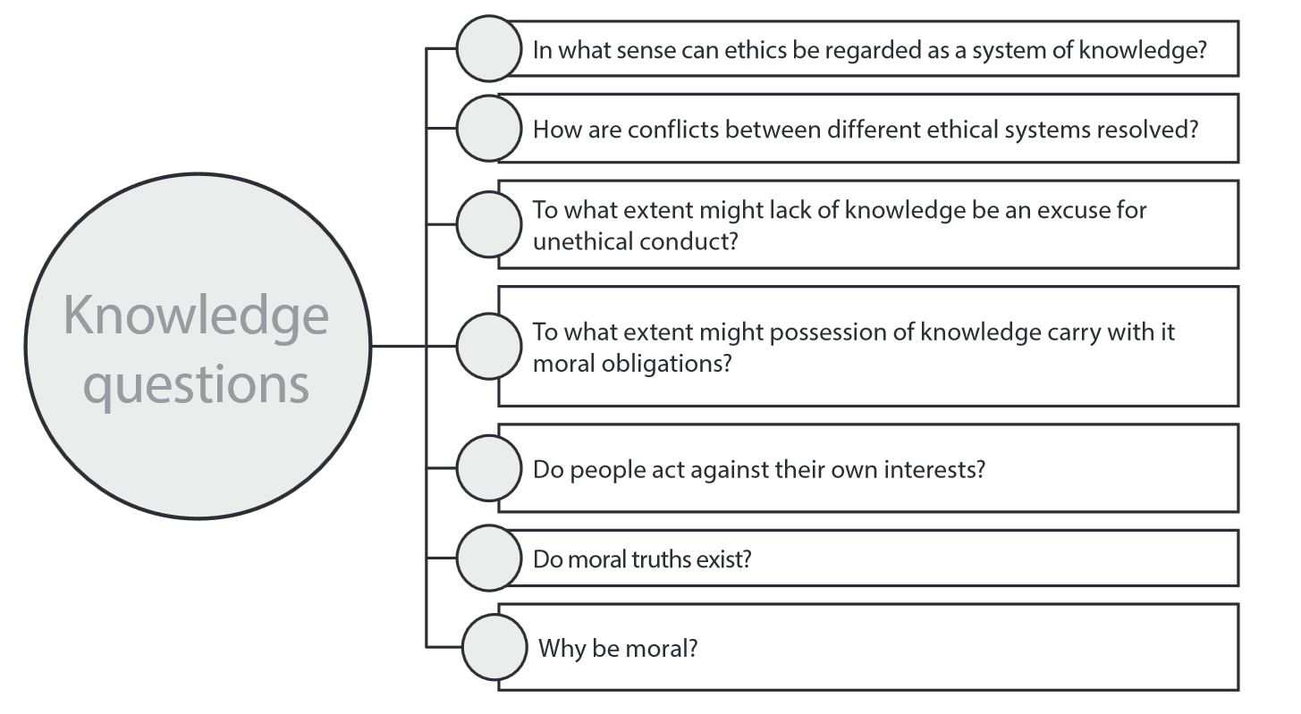
KI: Ethics
Has both shared and personal knoweldge, declarative and procedural knowledge.
Social discourse?
If I do not know if a certain act is unethical in one culture and you still do that, are you then excused? Schützt Unwissen?
If I know who stole the money, am I then ethically responsible of telling the police?
Maybe if they place a moral law above their own interests?
Which definition of truth you want me to use?
Why not? If you act immorally, then do you still adhere to your own moral standards? Amorality, immorality? No moral principles are still morals?

Slide 25
KI: Science
Reliable enough to serve a purpose?
Often one does not?
Fewer assumptions? Ockhams rule? Fuller explanation of all observed facts?
Reason? Mind experiments?
Paradigm shifts? Popper‘s falsification principle?
Support by multiple observations? No 100% certainty in the sciences anyway?

Slide 26
Human sciences
Statistics?
Are they falsifiable? Psychoanalysis is not falsifiable. Is psachoanalysis a pseudoscience (Popper)?
What is a law? Can the concept of scientific laws even be applied to non-deterministic systems, such as humans? Or are humans deterministic?
Statistics might help out here. Much statistics done in psychology.

Slide 27
History
Why should it be? Objectivity maybe also a problem?
Multiple sources? Sources in agreement with other sources?
Is this not what history is/should be about? Or not?
Language determines what can be known (linguistic relativity? Emotional language?
Similar to a scientific theory? Those that are based on fewer assumptions are better? Those that take most facts into consideration are better?

Slide 28
Arts

Slide 29
AOK: History
History = facts + interpretation
Example 1: Feldpost
Example 2: Reading „Im Westen nichts Neues“
Activity: What are the three most important inventions? Who are the three most important people?

Slide 30
AOK History: Im Westen Nichts Neues
Haie Westhus wird mit abgerissenem Rücken fortgeschleppt; bei jedem Atemzug pulst die Lunge durch die Wunde. Ich kann ihm noch die Hand drücken; -»is alle, Paul«, stöhnt er und beißt sich vor Schmerz in die Arme.
Wir sehen Menschen leben, denen der Schädel fehlt; wir sehen Soldaten laufen, denen beide Füße weggefetzt sind; sie stolpern auf den splitternden Stümpfen bis zum nächsten Loch; ein Gefreiter kriecht zwei Kilometer weit auf den Händen und schleppt die zerschmetterten Knie hinter sich her; ein anderer geht zur Verbandstelle, und über seine festhaltenden Hände quellen die Därme, wir sehen Leute ohne Mund, ohne Unterkiefer, ohne Gesicht; wir finden jemand, der mit den Zähnen zwei Stunden die Schlagader seines Armes klemmt, um nicht zu verbluten, die Sonne geht auf, die Nacht kommt, die Granaten pfeifen, das Leben ist zu Ende.
Doch das Stückchen zerwühlter Erde, in dem wir liegen, ist gehalten gegen die Übermacht, nur wenige hundert Meter sind preisgegeben worden. Aber auf jeden Meter kommt ein Toter.
To what extent are emotions, even subjectivity necessary to understand History? How can Literature/Arts help us understant History? Facts and interpretation in the above account? Why do we not read novels like the above one in History class?

Slide 31
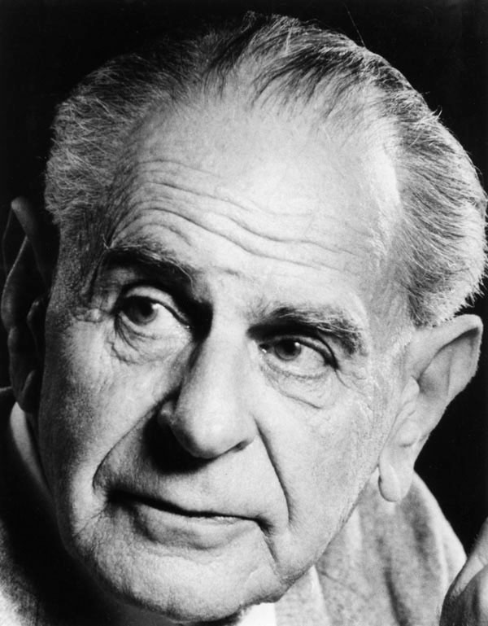
AOK: Natural Science
Sir Karl Popper‘s principle of falsification
Demonstration using playing cards.

Slide 32
AOK: Mathematics
c² = a² + b²
c = 3² + 4²
c = 25
c = 5 and -5
Is the answer -5
now correct or not?
c = ?
a = 3
b = 4

Slide 33
Problems, Misconceptions
Misunderstanding of AOK „History“. History is our current view of the past. How has this changed (or not changed) over the years? It is not simply an example of an event that happened in the past.
  Good example: „I have seen the 9/11 attacks live on TV. How does my emotional involvement make me biased?“
  Bad example: „People of the stone age.“ This is simply something that happened long time ago, but it is not our current view of it.
Misunderstanding of AOK „Human science“: It is the study of human behavior (psychology, maybe economics). It is not the study of the human body (medicine, biology).
Misunderstanding of WOK perception: This refers to sense perception (eyes, ears) and not on how a situation is perceived. Not: „I perceive this to be a difficult math problem.“
Misunderstanding of WOK logics: This is formal logics. Not: „It is logical that the sun is shining.“ This would be sense perception. Be careful of how words are used in everyday language compared to in TOK.

Slide 34
Why writing the TOK Essay (and other essays) is especially difficult for Austrian students
Different essay writing traditions: In simple words, so far we placed a very strong emphasis on grammar and spelling and not so much on structure, arguments and supporting examples, which are important for the IB. The neue Reifeprüfung has made it better, but it is still a very far away from what the standard of the IB is.
Different essay writing traditions between Austria/Germany and the Anglo-American tradition: Philosophy essays in the German speaking world were traditionally closely linked to literature („literarisch“). Simplified: Fancy, eloquent language was considered good. „Who cares about paragraphs.“ The TOK essay is much more analytical, structured. The TOK essay is not creative writing!
LISA German teacher A: „Die Beherrschung der deutschen Sprache war historisch gesehen immer ein Klassenunterscheidungsmerkmal.“ – Simplified: The purpose of the German language was not to communicate but to make you appear smart, so that you can say that you belong to the upper class.
LISA German teacher B: „Es ist unglaublich was das IB alles durchgehen lässt. Bei uns wäre das schon längst ein nicht genügend.“ (im Bezug zur Rechtschreibung, Grammatik). The IB places a much stronger emphasis on communication than on technical language aspects.
English is a second language for most. They can not express themselves as acurately as native speakers and will cover their insecurity by using long, winding, complex sentences that do not communicate their point clearly.

Slide 35
Why writing the TOK Essay (and other essays) is especially difficult for Austrian students
Students are conditioned from the Schularbeiten to start writing without first planning out the paragraphs. This has a name. It is called „train of thought writing“. This is a disaster for TOK as students might contradict themselves. The TOK essay is a different „Textsorte“.
Train of thought (bad for TOK) Structured (good for TOK)
A vague idea
Is developed into
A final conclusion: the answer
(during the writing process)
Intro: Answer to the question
Body answers the title: Supporting ideas, examples, counter examples that give answer the title
Body answers the title: Supporting ideas, examples, counter examples that give answer the title
Body answers the title: Supporting ideas, examples, counter examples that give answer the title
Conclusion: summary and answers the title

Slide 36
Essay writing rule of thumb
An essay has a minimum of 5 paragraphs. The TOK essay will need more, due to ist length.
  1 Introduction: This one answers (!!!!!) the title question explicitly. Here you say what you are going to say.
  3 body paragraphs: Here you say it.
  1 conclusion: Here you say what you have said.
A paragraph has a minimum of 3 sentences. The TOK essay might need more (maybe 5 sentences)
  An introductory thesis sentence (which answers (!!!!!) the title question)
  A supporting body sentence (with an example)
  A concluding sencence (with a possible counter argument)
The TOK essay is not creative writing. It is an argumentative essay. And convincing arguments must be balanced.

Slide 37
May 2017 TOK Essay Titles
1. “It is only knowledge produced with difficulty that we truly value.” To what extent do you agree with this statement?
2. “Facts are needed to establish theories but theories are needed to make sense of facts.” Discuss this statement with reference to two areas of knowledge.
3. Should key events in the historical development of areas of knowledge always be judged by the standards of their time?
4. “In the production of knowledge, traditions of areas of knowledge offer correctives for ways of knowing.” To what extent do you agree with this statement?
5. Given access to the same facts, how is it possible that there can be disagreement between experts in a discipline? Develop your answer with reference to two areas of knowledge.
6. “Humans are pattern-seeking animals and we are adept at finding patterns whether they exist or not” (adapted from Michael Shermer). Discuss knowledge questions raised by this idea in two areas of knowledge.

Slide 38
I do not teach the subject TOK. Why should I care?
To provide TOK examples from your subject so that the students can write the TOK essay and do the TOK presentation!
An essay structure is also relevant for the extended essay.
Internal assessment (IAs) have to be written for the different subjects and they also place a strong focus on structure and communication of ideas (and less on linguistic aspects).
Language is a tool for communication and not only an ends in itself. Students can write the nicest sentences, all of them correct, but if they do not communicate the poin, if there is no consistent argument, insufficient support, insufficient critical reflection, then the students will not get a lot of points. Grammar and spelling are assumed to be correct.

Slide 39
The core idea(s) of TOK
(maybe of philosphy in general)
To find out the „real“ issue behind things. The Knowledge Issue (KI).
To critically question the sources of knowledge in one‘s own subject.
The idea is not to provide a final definitive answer to Knowledge Issues.
If students show an awareness of the issues then this is already much.
Important: a clear answer can be also a balanced answer! To does not have to be a yes/no answer! It can be a „it depends“ answer, or a „yes, but…“ or „no, but…“ answer.

Slide 40
Do you like chocolate cake or ice cream?
Give a clear balanced answer!
Students are very often confused, becasue they think that clear answers can not be balanced. They think that a clear answer is a black/while, an either/or answer.
Not an answer: „Sometimes I like chocolate cake, sometimes I prefer ice cream. It depends. Different people simply like different things. There is no answer to this question.“ Student thinks that the answer must be yes/no.
Not an answer: „Chocolate cake is always better. I will show this in this essay.“ not balanced.
Not an answer: „Humans have been baking cakes since the beginning of humankind. In this essay I will answer the question on whether cake or ice cream is better.“ Student rephrases the question without answering it.
Not an answer: „The answer does not matter, because both are not healthy. I do not like either and will show why you should not eat them.“ Student tries to change topic.
Answer: „I like chocolate cake during winter and ice cream in summer, becasue the cake gives me energy when it is cold and the ice cream cools me when the sun is shining.“ Maybe you agree, or not. It does not mapper. The student provided support for the argument.

Slide 41
Do it like Kant: Answer the title in the introduction!
Knowledge Question
IMMANUEL KANT: Was ist Aufklärung?
AUFKLÄRUNG ist der Ausgang des Menschen aus seiner selbstverschuldeten Unmündigkeit. Unmündigkeit ist das Unvermögen, sich seines Verstandes ohne Leitung eines anderen zu bedienen. Selbstverschuldet ist diese Unmündigkeit, wenn die Ursache derselben nicht am Mangel des Verstandes, sondern der Entschließung und des Mutes liegt, sich seiner ohne Leitung eines andern zu bedienen. Sapere aude! Habe Mut, dich deines eigenen Verstandes zu bedienen! ist also der Wahlspruch der Aufklärung.
Answer of the question in the first line of the introduction!
Define terms („Unmündigkeit“, „selbstverschuldet“) without giving a dictionary definition.
Answer the title question again using simpler words. Concluding sentence of the paragraph.

